Slide 1

UNEMPLOYMENT COMPENSATION
WHAT EMPLOYERS NEED TO KNOW
Employer Conference
August 6, 2014
Notes:
Resources used in the development of this presentation:
http://www.vec.virginia.gov/vecportal/employer/pdf/employerhandbook20130808.pdf
http://leg1.state.va.us/cgi-bin/legp504.exe?000+cod+TOC60020000005000000000000 TAX Regs
http://leg1.state.va.us/cgi-bin/legp504.exe?000+cod+TOC60020000006000000000000 Benefits Regs

Slide 2
Purpose of the UI Program
To provide benefits to the regularly employed members of the labor force who become unemployed due to no fault of their own.

Slide 3
Virginia’s Responsibility
Design & administer the UI program within the framework of Federal law.

Slide 4
Unemployment Insurance Program is funded by the employer.
FUTA – Paid by the employer to the Federal Gov’t for administration of Federal & State program operating costs.
SUTA – Paid by the employer to the State UI Trust Fund to pay benefits.

Slide 5
Earnings Requirement
Have earnings of $3000 during two quarters of the base period.
  Base Period:
    First four of the last five completed calendar quarters.
    Alternate Base Period: Last four completed calendar quarters.
  Minimum of $60 for 12 weeks
  Maximum of $378 for 26 weeks ($18,900.01 earnings during two quarters of the base period).
Notes:
To qualify for benefits, an individual must have earned at least a total of $3000 in two quarters in the base period. Currently the maximum weekly benefit amount is $378 and the minimum is $60. Individuals must have earned at least $18,900.01 in two quarters during the base period to qualify for the maximum weekly benefit amount. Benefit duration varies from 12 to 26 weeks, also depending on wages earned in the base period.

Slide 6
Claims Process
Initial claim filed by employee
Wage and separation report sent to employer
Separation reason is indicated by the claimant.

Slide 7
Claims Process (continued)
Wage and Separation Report
Mailed to the address on file.
Return by the date that’s indicated on the form.
You should provide the name and number of a person with first hand knowledge in your company to be contacted for additional information. The deputy will contact that person.
Please answer the questions on the form with “who, what, when, where, & how”.
Attach any relevant company policy, any acknowledgment of that policy, any warnings that were provided, any witness statements, etc.

Slide 8
Who’s on First?
Claimant Discharged (fired):
The burden is on the employer to prove the claimant was fired due to misconduct.
Claimant Quit
The employer must show the claimant was not forced to quit, and once established the claimant must show good cause for leaving.

Slide 9
Wage & Separation Report
This is a legal document.
The claimant has a right to know the information you provide.
Do not put anything on this report you would not say to the claimant or say in a court of law.

Slide 11
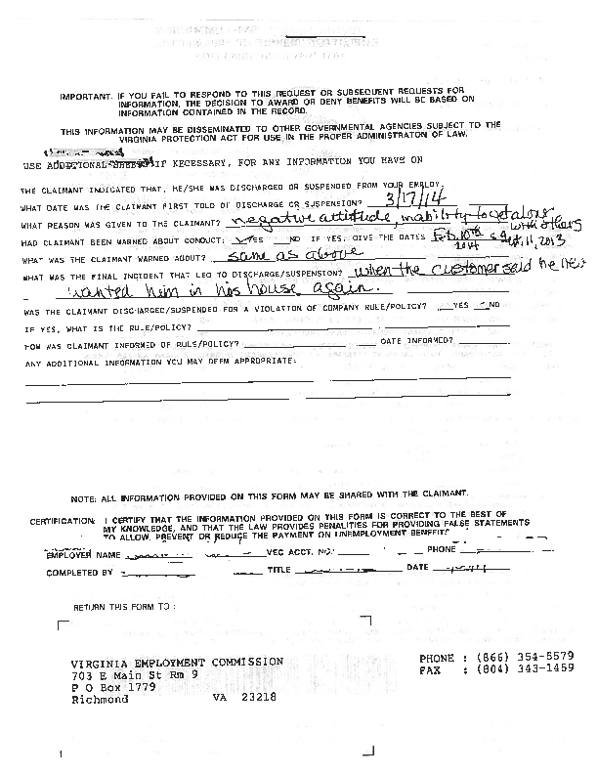

Slide 12
What to Do When the Phone Rings
Answer the deputy’s questions with facts.
Do not digress on irrelevant matters.
Reference the relevant documentation that supports the separation.
Make certain witness(es) with first hand knowledge of the events are available to testify.

Slide 13
When the Hearing is Over
The Deputy will issue a written determination. The determination will be based upon the information obtained as a result of the hearing. This decision will be mailed to both the employer and the claimant.

Slide 14
What if I Do Not Agree with the Decision?
Appeal Rights:
Either party may file an appeal. This can be done on line, in writing, or by FAX. The appeal must be filed within 30 days from the date the decision was mailed.
If the claimant is qualified, they may continue to draw benefits pending the outcome of the appeal.

Slide 15
Cost Management Tips
Evaluate new employees before 30 work days or 240 hours have passed.
Develop a written policy manual.
Require that every employee acknowledge in writing their understanding of your policy.
Follow your policy and document any disciplinary actions.
Return the Wage and Separation report on time.
Participate in the fact finding hearing.
Supply the first hand testimony and any written documentation.
File an appeal if you disagree with the outcome.
Review all benefit charges for accuracy.
Contact the VEC for any clarification of for any correction.

Slide 16
Misconduct Defined
A deliberate violation of reasonable company rule, or
Acts or omissions that, by their nature or reoccurrence, showed a willful disregard of the employer’s interests.

Slide 17
Burden of Proof
The burden of proof is on the employer to show misconduct by a preponderance of evidence.
Once the employer has proven misconduct, the burden shifts to the claimant to prove mitigating circumstances.

Slide 18
Mitigating Circumstances
Employee may avoid a disqualification if there was a showing of mitigating circumstances.
Generally, these will be circumstances that tend to show the employee’s actions were not deliberate or willful

Slide 19
What Is Misconduct in Connection with Work?
Claimant may be disqualified for misconduct only if it is in connection with work.
The test is whether there is a reasonable link between the act of misconduct and the claimant’s job.

Slide 20
Examples of Acts that can Constitute Misconduct
Excessive absenteeism or tardiness without proper notice or adequate justification.
Insubordination.
Fighting on the job.
Falsification of job application or company records.
Willful destruction of company property.

Slide 21
Examples of What is Not Misconduct
Poor job performance due to inability.
Poor attendance due to illness where company has been properly notified.
Self-defense from an unprovoked attack.

Slide 22
Examples of Off Duty Acts that are Connected with Work
Loss of driver’s license for DUI occurring off duty, but job requires valid driver’s license.
Loss of security clearance due to conviction for off-duty criminal act connected with work.

Slide 23
Preparing for a Misconduct Case
Review company rules and policies to ensure they are clear, understandable and known to all employees.
Ensure managers & supervisors know the rules and consistently enforce them.
Require adequate documentation of rule violations & disciplinary action taken.

Slide 24
Benefit Liability
The last 30 day or 240 hour employer from whom claimant is separated is liable.
Any reimbursable employer in the base period can be assessed a percentage of the charge.
Notes:
Not all employing units in Virginia are subject to the taxing provisions of the unemployment compensation law. Coverage (tax liability) is determined by the number of workers employed, the duration and nature of services performed, and the amount of wages paid for services in employment. Once the liability conditions are met for your type of employment, you are required to report the total payroll for the entire year, by quarter, and pay the appropriate amount of taxes. Regulation 16 VAC 5-20-10
You are automatically liable for coverage if you:
• acquire a business, which is liable under the law; (You also may be responsible for any sum owed by the seller.)
• are liable to the federal government for Federal Unemployment Tax (FUTA);
• are a state, local government, or political subdivision. §60.2-210
Most employers are liable if you have one or more employees who work for any portion of a day in twenty different weeks in a calendar year, or if your total gross payroll for any calendar quarter is $1,500 or more. §60.2-210. The exceptions are domestic, nonprofit or agricultural employing units.

Slide 25
Employer Charges
Taxable Employer
Quarterly charge statement will include employee/claimant by name & amount of unemployment insurance paid.
Experience rating is determined in December for the upcoming calendar year and tax rate notices mailed to employers.

Slide 26
Benefit Ratio
Charges to the employer are based on the Benefit Ratio.
  Benefit Ratio equals
  Benefit Charges (within 4 yr. period)
  Paid Taxable Wages (1st $8000/worker)
  The computed tax rate is determined by applying the resulting percentage and the trust fund balance factor to the rate tables provided by the law.
  The lower the charges, the lower the ratio. The lower the ratio the lower the tax.
Notes:
The benefit ratio is obtained by dividing the total amount of benefits charged against the account by the total of the paid taxable payrolls. The computed tax rate is determined by applying the resulting percentage and the trust fund balance factor to the rate tables provided by the law. The pool cost charge is added to all employers’ tax rates to compensate for charges that cannot be assigned to any specific Virginia employer. When the trust fund balance does not exceed 50% of solvency, an additional charge must be placed on all employers.

Slide 27
Tax Rates
  Minimum – 0.52%
  Maximum – 6.62%
  New Employer – 2.92%

Slide 28
Employer Charges
Reimbursible
Detailed billing statement is mailed showing all charges for the quarter.
Payment coupon will be included.
Tax charges must be paid 30 days from the date mailed to avoid interest charges.

