Slide 1

Unemployment Compensation Financing and an Introduction to the New VEC Employer Self Service
Presented by
Robert K. Prettyman – Tax

Slide 2
Agenda
Overview of UC Financing
Federal UC taxation
State UC Taxation
Methods of Filing Tax Returns
Introduction of the new iFile
Resources

Slide 3
Overview
Federal Unemployment Tax Act (FUTA)
  Created framework for federal-state partnership
  Provides funding mechanism for program administrative funding
  Payroll tax paid by employers to IRS
  Establishes requirements for state laws

Slide 4
Overview (con’t)
State unemployment insurance laws
  Establish benefit levels and eligibility criteria consistent with federal requirements
  Impose and collect experience-rated payroll information and tax on employers to pay benefits
  Federal law limits the use of these funds to the payment of UC benefits

Slide 5
Federal Unemployment Tax-Purpose
Provides funding mechanism for state program administration of UI and Job Service programs
Some of the federal unemployment tax dollars set aside for
  Federal share of extended benefits
  Loans to states

Slide 6
Federal Unemployment Tax – Rate & Wage Base
Federal unemployment tax is set at 6%
This tax is not experience-rated
Tax rate assessed on the first $7,000 of wages paid to each employee each year

Slide 7
FUTA Tax Credit & Conformity
Virginia’s current UI law is in conformity with federal law and there are no outstanding loans; therefore, Virginia employers pay a federal unemployment tax of 0.6% (90% credit on 6% = 0.6)
When the rate of 0.6% is applied to federal taxable wage base of $7,000 the tax is $42 per employee per year.

Slide 8
Methods of filing
Web Upload
  Ideal for larger employers
  Quick and easy way to file
    http://www.tax.virginia.gov/content/web-upload-information
QuickBooks
  File transfer for QuickBooks users
Large payroll providers such as ADP, Ceridian and Paychex by file transfer

Slide 9
Methods of filing – con’t
iFile https://www.business.tax.virginia.gov/V TOL/Login.seam
Paper
    http://www.vec.virginia.gov/employers/tax-registration

Slide 10
Register as a Tax Preparer
Register your services to be able to pay taxes on behalf of your clients with the Virginia Employment Commission and Virginia Department of Taxation. By registering, you will become eligible to be assigned as Tax Preparer by a business who is already an iFile user.
  https://www.business.tax.virginia.gov/VTOL/TaxPreparerRegistration.seam

Slide 11
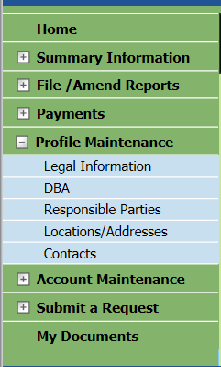
What can I do in iFile?
File and pay quarterly UI taxes
Be notified of and review correspondence
Change your address and other account info
Request Federal Certification. Clearance Certificate, Refund, Payment Agreement
Account Summary

Slide 12
Who is iFile and iReg for?
Employers with 99 or less employees may submit their payroll and file their taxes using iFile
All new employers can submit an employer registration using iReg

Slide 13
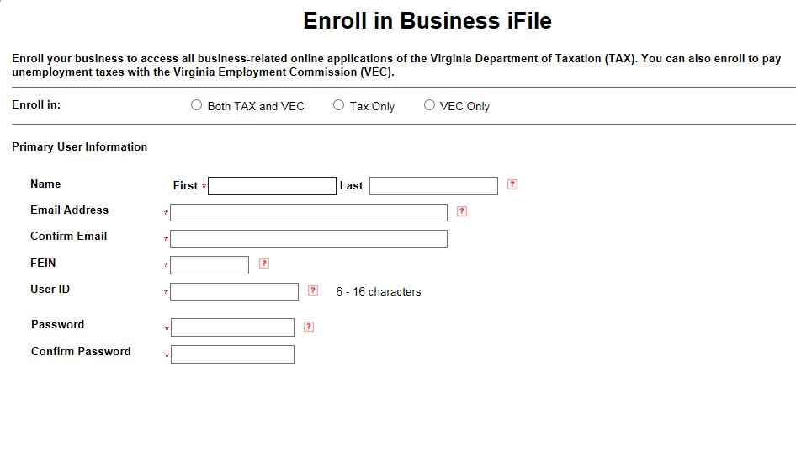
How do I begin to use iFile?
Existing VEC and Tax employers must enroll to use iFile. You will need your VEC account number, Fed ID and amount of last tax return. New employer registration takes the place of enrollment.

Slide 14
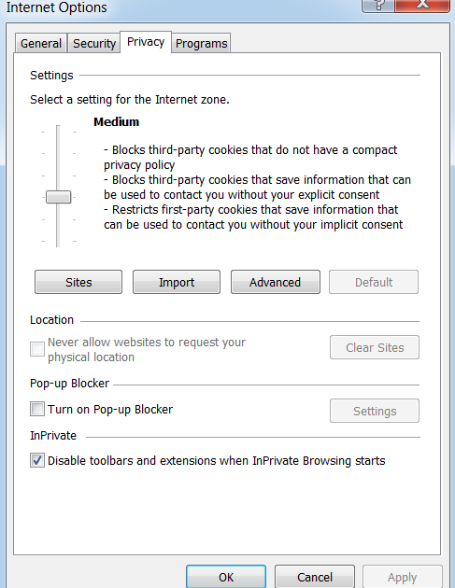
Pop up Blockers
Pop up blockers keep certain functions such as address validation from working. You need to disable pop up blockers for this web site.

Slide 15
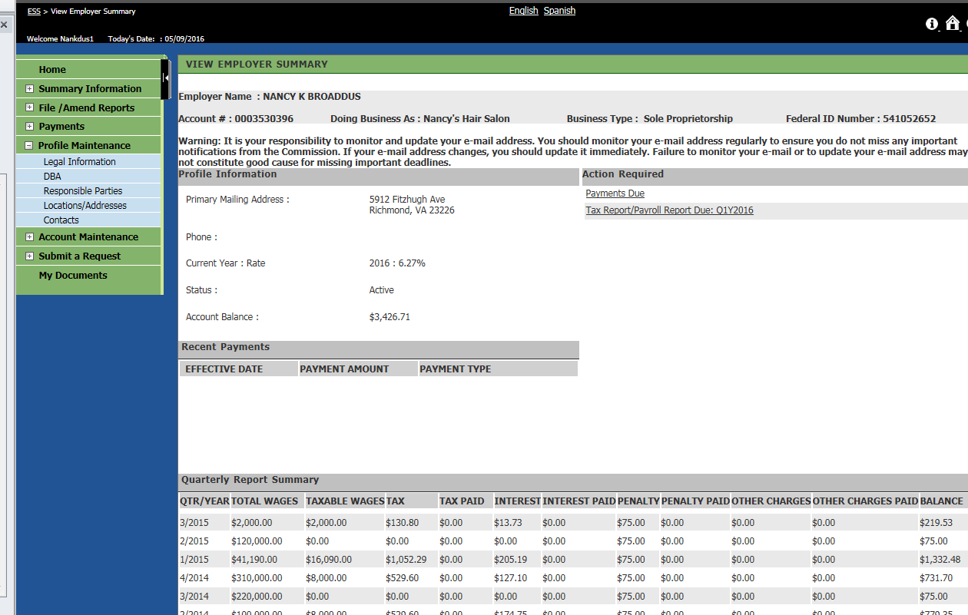
Your VEC Home Page

Slide 16
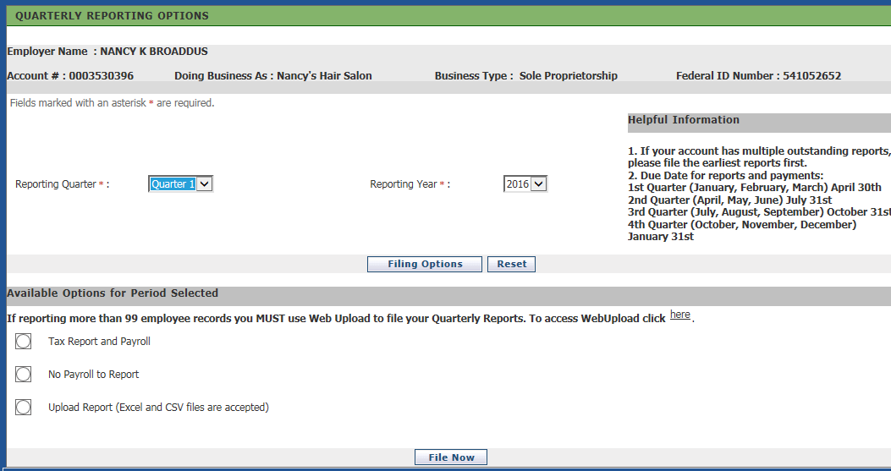
Choose the quarter and the method

Slide 17
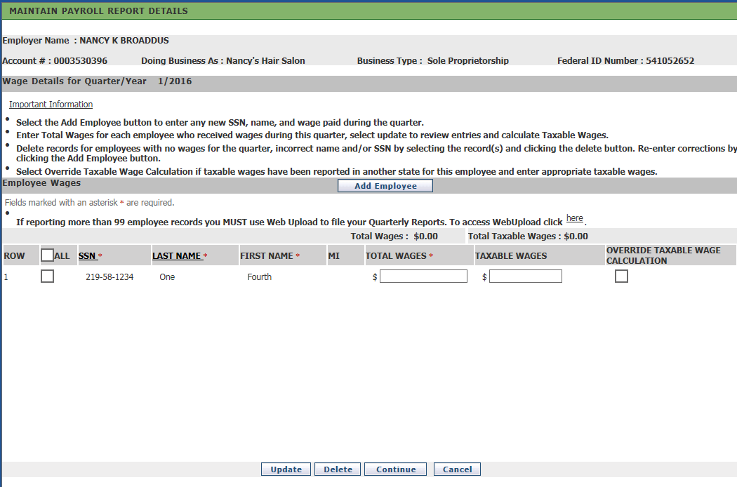
Add New Employees

Slide 18
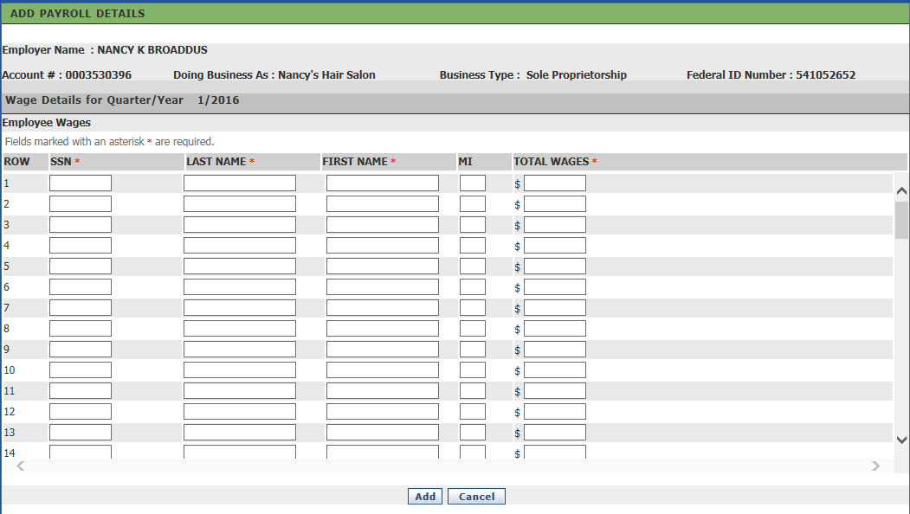
Click “Add”

Slide 19
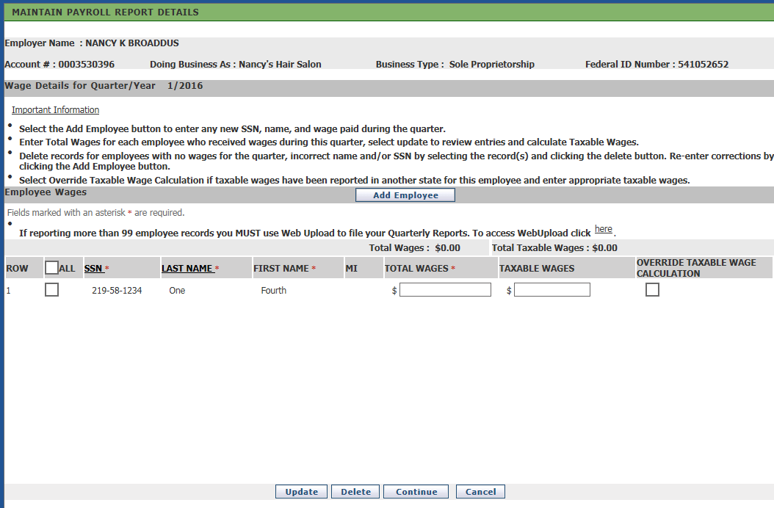
Enter the wages for existing employees

Slide 20
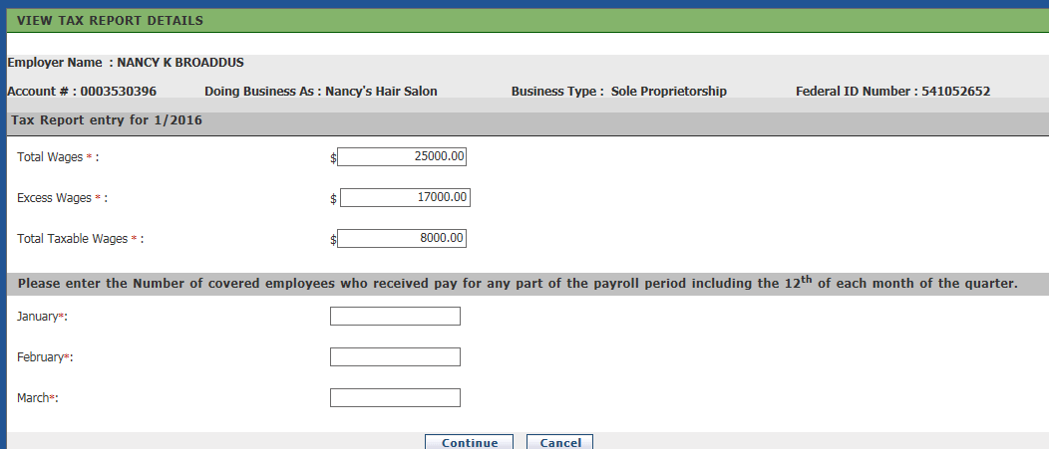
System calculates excess wages. Simply add employee count and continue.

Slide 21
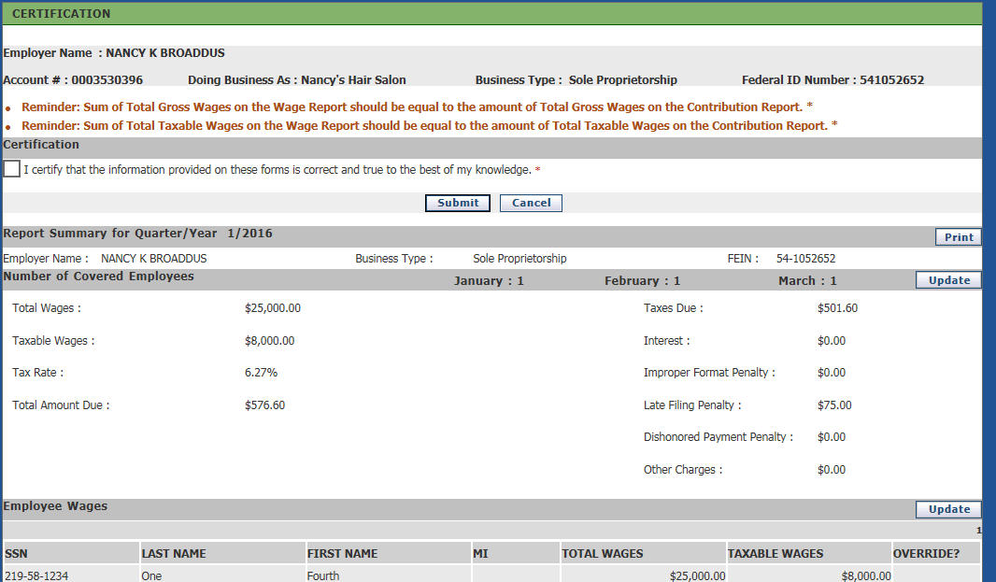
Check to certify, print and submit

Slide 22
Questions
?

