Slide 1

UNEMPLOYMENT COMPENSATION
Successfully Managing Unemployment Claims
What Employers Need to Know
August 9, 2016
Notes:
Resources used in the development of this presentation:
http://www.vec.virginia.gov/vecportal/employer/pdf/employerhandbook20130808.pdf
http://leg1.state.va.us/cgi-bin/legp504.exe?000+cod+TOC60020000005000000000000 TAX Regs
http://leg1.state.va.us/cgi-bin/legp504.exe?000+cod+TOC60020000006000000000000 Benefits Regs

Slide 2
Purpose of the
Unemployment Insurance (UI) Program
To provide benefits to the regularly employed members of the labor force who become unemployed due to no fault of their own (Lack of Work).

Slide 3
Virginia’s Responsibility
Design & administer the UI program within the framework of Federal law.

Slide 4
Unemployment Insurance Program is funded by the employer
FUTA – Paid by the employer to the Federal government for administration of Federal & State program operating costs
SUTA – Paid by the employer to the State UI Trust Fund to pay benefits

Slide 5
Earnings Requirement
Have earnings of $3,000 during two quarters of the base period.
  Base Period:
    First four of the last five completed calendar quarters
    Alternate Base Period: Last four completed calendar quarters
  Minimum of $60 for 12 weeks
  Maximum of $378 for 26 weeks ($18,900.01 earnings & over during two quarters of the base period)
Notes:
To qualify for benefits, an individual must have earned at least a total of $3,000 in two quarters in the base period. Currently the maximum weekly benefit amount is $378 and the minimum is $60. Individuals must have earned at least $18,900.01 in two quarters during the base period to qualify for the maximum weekly benefit amount. Benefit duration varies from 12 to 26 weeks, also depending on wages earned in the base period.

Slide 6
Claims Process
Initial claim filed by employee
Wage and Separation Report sent to employer
Separation reason is indicated by the claimant

Slide 7
continued…..Claims Process
Wage and Separation Report
Provide the name and number of a person in your company with first hand knowledge to be contacted for additional information. The Deputy will contact that person.
Answer the questions on the form with “who, what, when, where & how”
Attach any relevant company policy, any acknowledgment of that policy, any warnings that were provided, any witness statements, etc.
Mailed to the address on file
Return by the date that is indicated on the form

Slide 8
Wage & Separation Report
This is a legal document.
The claimant has a right to know the information you provide.
Do not put anything on this report you would not say to the claimant or say in a court of law.
*Note: Effective July 7, 2013 the law was amended so that penalties may be applied to an employer if requests for information are not returned timely.

Slide 10
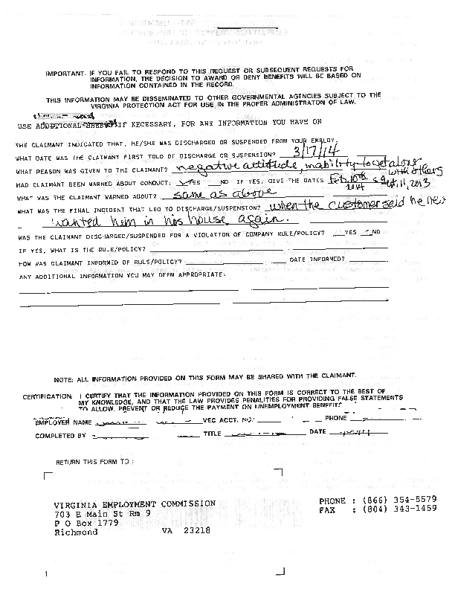

Slide 11
Who’s on First?
Claimant Discharged (fired):
The burden is on the employer to prove the claimant was fired due to misconduct.
Claimant Quit
The employer must show the claimant was not forced to quit, and once established, the claimant must show good cause for leaving.

Slide 12
What to do when the Phone Rings
Answer the Deputy’s questions with facts
Reference the relevant documentation that supports the separation
Make certain witnesses with first hand knowledge of the events are available to testify
Just The Facts!
Notes:
Do not digress on irrelevant matters
May want to let the employers know that we have developed specific questions that the deputies are required to ask (Dynamic B60’s).

Slide 13
Facts are NOT
Opinions, speculations, assumptions, generalizations, evasions, predictions, conclusions made without corroborating evidence.
Notes:
Did the claimant deliberately break the machine?
I believe he did. (opinion)
He was the only one close to the machine when it stopped working. (inference)
He was a careless worker. (opinion)
He was always a troublemaker. (generalization)
If he didn’t break the machine, can you tell me who did? (evasion)
I knew the machine would break if he continued to operate in the same manner. (prediction)
The machine didn’t break itself. He was operating it at the time. He broke it. (conclusion)

Slide 14
Kinds of Facts
General background facts are background information, broadly stated including multiple possibilities, eg,
  The claimant was discharged.
Material facts are pertinent facts & precise eg,
  The claimant was discharged for stealing tennis shoes from the distribution warehouse.
Notes:
Under the second example - both parties agreed with the employer statement regarding the reason given to the claimant for his discharge; therefore, this is considered a fact. However, this may not be the end of the fact finding process. Unless the claimant agrees that he was stealing the tennis shoes, more facts are needed to reach a decision regarding the claimant discharge issue.

Slide 15
When the Hearing is Over
The Deputy will issue a written determination.
The determination will be based upon the information obtained as a result of the hearing.
This decision will be mailed to both the employer and the claimant.

Slide 16
What if I Do Not Agree with the Decision?
Appeal Rights:
Either party may file an appeal. This can be done online, in writing or by FAX. The appeal must be filed within 30 days from the date the decision was mailed.
If the claimant is qualified, they may continue to draw benefits pending the outcome of the appeal.

Slide 17
Misconduct Defined
A deliberate violation of reasonable company rule, or
Acts or omissions that, by their nature or reoccurrence, showed a willful disregard of the employer’s interests.

Slide 18
Burden of Proof
The burden of proof is on the employer to show misconduct by a preponderance of evidence.
Once the employer has proven misconduct, the burden shifts to the claimant to prove mitigating circumstances.

Slide 19
Mitigating Circumstances
Employee may avoid a disqualification if there was a showing of mitigating circumstances.
Generally, these will be circumstances that tend to show the employee’s actions were not deliberate or willful.

Slide 20
What Is Misconduct in Connection with Work?
Claimant may be disqualified for misconduct only if it is in connection with work.
The test is whether there is a reasonable link between the act of misconduct and the claimant’s job.

Slide 21
Examples of Acts that can Constitute Misconduct
Excessive absenteeism or tardiness without proper notice or adequate justification
Insubordination
Fighting on the job
Falsification of job application or company records
Willful destruction of company property

Slide 22
Examples of What is
Not Misconduct
Poor job performance due to inability
Poor attendance due to illness where company has been properly notified
Self-defense from an unprovoked attack

Slide 23
Examples of “Off Duty” Acts that are Connected with Work
Loss of driver’s license for DUI occurring off duty, but job requires valid driver’s license
Loss of security clearance due to conviction for off-duty criminal act connected with work

Slide 24
Preparation for a Dismissal to Support Misconduct
Review company rules and policies to ensure they are clear, understandable and known to all employees.
Ensure managers & supervisors know the rules and consistently enforce them.
Require adequate documentation of rule violations & disciplinary action taken.
Notes:
Documentation! Documentation! Documentation!

Slide 25
Benefit Liability
The last 30 day or 240 hour employer from whom claimant is separated is liable.
Any reimbursable employer in the base period can be assessed a percentage of the charge.
Notes:
Not all employing units in Virginia are subject to the taxing provisions of the unemployment compensation law. Coverage (tax liability) is determined by:
The number of workers employed
The duration and nature of services performed, and
The amount of wages paid for services in employment
Once the liability conditions are met for your type of employment, you are required to report the total payroll for the entire year, by quarter, and pay the appropriate amount of taxes. Regulation 16 VAC 5-20-10
You are automatically liable for coverage if you:
• Acquire a business, which is liable under the law (You may also be responsible for any sum owed by the seller.)
• Are liable to the federal government for Federal Unemployment Tax (FUTA)
• Are a state, local government, or political subdivision §60.2-210
Most employers are liable if you have one or more employees who work for any portion of a day in twenty different weeks in a calendar year, or if your total gross payroll for any calendar quarter is $1,500 or more. (§60.2-210) The exceptions are domestic, non-profit or agricultural employing units.

Slide 26
Employer Charges
Taxable Employer
Quarterly charge statement will include employee/claimant by name & amount of unemployment insurance paid
Experience rating is determined in December for the upcoming calendar year and tax rate notices mailed to employers

Slide 27
Benefit Ratio
Charges to the employer are based on the Benefit Ratio.
Benefit Ratio equals
  Benefit Charges (within 4 yr period)
  Paid Taxable Wages (1st $8000/worker)
  The computed tax rate is determined by applying the resulting percentage and the trust fund balance factor to the rate tables provided by the law.
  The lower the charges, the lower the ratio. The lower the ratio the lower the tax.
Notes:
The benefit ratio is obtained by dividing the total amount of benefits charged against the account by the total of the paid taxable payrolls. The computed tax rate is determined by applying the resulting percentage and the Trust Fund balance factor to the rate tables provided by the law. The pool cost charge is added to all employers’ tax rates to compensate for charges that cannot be assigned to any specific Virginia employer. When the trust fund balance does not exceed 50% of solvency, an additional charge must be placed on all employers.

Slide 28
Employer Charges
Reimbursable
Detailed billing statement is mailed showing all charges for the quarter
Payment coupon will be included
Tax charges must be paid 30 days from the date mailed to avoid interest charges

Slide 29
Cost Management Tips
Evaluate new employees before 30 work days or 240 hours have passed.
Develop a written policy manual.
Require that every employee acknowledge in writing their understanding of your policy.
Follow your policy and document any disciplinary actions.
Return the Wage and Separation Report on time.
Participate in the Fact Finding Hearing.
Supply the first hand testimony and any written documentation.
File an appeal if you disagree with the outcome.
Review all benefit charges for accuracy.
Contact the VEC for any clarification or any correction.

Slide 30

VEC Central Office
703 E. Main St
Richmond, VA 23219
Mailing Address
P.O. Box 1358
Richmond, VA 23218-1358
866-832-2363
vec.virginia.gov

